Slide 1
DIGITAL PORTFOLIO
STUDENT NAME : VASANTHAKUMAR R
REGISTER NO : 24131030500121035
NMID : EFAFC331EA02D15968F4D974D50C25BB
DEPARTMENT : BCA-II Year
COLLEGE : GOVERNMENT ARTS COLLEGE , ANNAMALAI UNIVERSITY ,CHIDAMBARAM.
1

Slide 2
PROJECT TITLE
Digital Portfolio
A Digital Portfolio is a personal website that displays an individual’s skills, education, projects, and achievements in a well-organized and attractive format.
It is designed using HTML, CSS, and optionally JavaScript to create a simple and responsive layout.

Slide 3
AGENDA
Problem Statement
Project Overview
End Users
Tools and Technologies
Portfolio design and Layout
Features and Functionality
Results and Screenshots
Conclusion
GitHub Link

Slide 4

PROBLEM STATEMENT
Problem statement
Students and freshers often struggle to showcase their skills and projects effectively.
Traditional resumes lack interactivity and creativity.
Recruiters prefer digital, responsive, and easily accessible portfolios.
4

Slide 5

PROJECT OVERVIEW
A Digital Portfolio Website built using HTML, CSS, and JavaScript.
Designed to display About Me, Skills, Education, Projects, and Contact Information.
Fully responsive and user-friendly.
5

Slide 6
PROJECT OVERVIEW
Key Features:
Navigation Bar – Links to Home, About, Skills, Education, and Contact sections.
Hero Section – Displays name, title, location, and social links.
About Section – Overview of education and career interests.
Contact Form – Allows visitors to get in touch via email.
Education Section –details Academic and learning focus.
Project Section
– Create a project detailed and satisfaction in customer.
Skills Section – Programming skills in Python, C++, and C.

Slide 7




WHO ARE THE END USERS?
Students – to showcase skills & achievements.
Job Seekers – for applying to internships and jobs
Recruiters & Companies – to evaluate candidates beyond resumes.
8

Slide 8

TOOLS AND TECHNIQUES
Frontend: HTML5, CSS3, JavaScript
Backend/Database (optional) : python & MySQL
Version Control : Visual Studio Code
Editor : Git & GitHub (for hosting/sharing)
9

Slide 9
PORTFOLIO DESIGN AND LAYOUT
Navigation Bar : Responsive, fixed at top with smooth scrolling.
Hero Section : Name, role, intro, resume download button, and social media links.
About Section : Profile image + short bio.
Skills Section : Progress bars for HTML, CSS, JS, Python, MYSQL.
Education Section : Timeline design showing BCA, HSC, and MS Office training.
Projects Section : Portfolio Website + Resume creation project.
Contact Section : Contact form (name, email, subject, message) + details.
Footer : Copyright info.

Slide 10
FEATURES AND FUNCTIONALITY
Features
Responsive Design – Works on desktop, tablet, and mobile.
Navigation Bar – Easy access to all sections (Home, About, Skills, Education, Contact).
Hero Section – Profile name, title, and location displayed prominently.
Interactive Buttons – social links and contact links open directly and resume download using with button .
Font Awesome Icons – For better visual representation of sections.
Contact Form – Users can send messages directly.
Footer – Displays copyright and basic information.

Slide 11
FEATURES AND FUNCTIONALITY
Functionality
Smooth Scrolling between sections using navigation links. Clickable Social Media Buttons to redirect to LinkedIn.
Form Submission to collect visitor messages (can be linked to email or database in future).
Mobile-Friendly Layout ensuring proper alignment across all devices.

Slide 12
RESULTS AND SCREENSHOTS
A fully functional, modern portfolio website that visually represents skills.
Home/Hero section
About & Skills
Education timeline
Project showcase
Contact form---.
3/21/2024 Annual Review
15

Slide 13
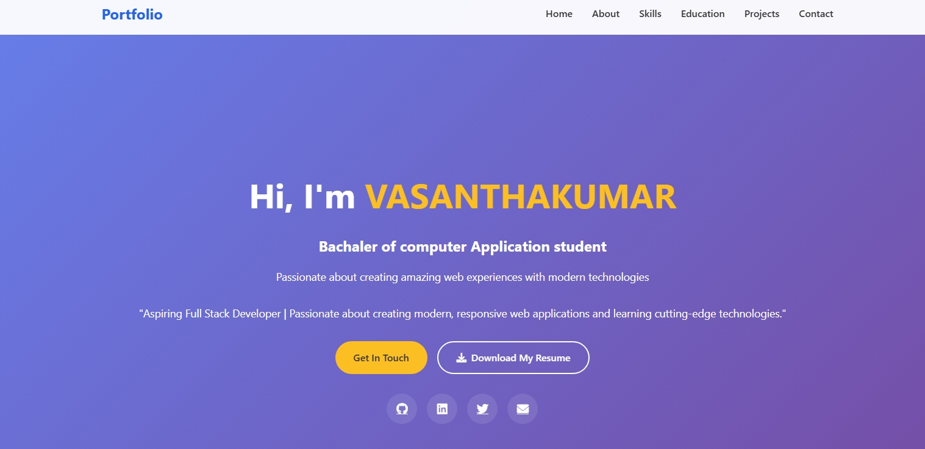
Screenshot
Homepage– Showing name, title, social application links , resume .

Slide 14
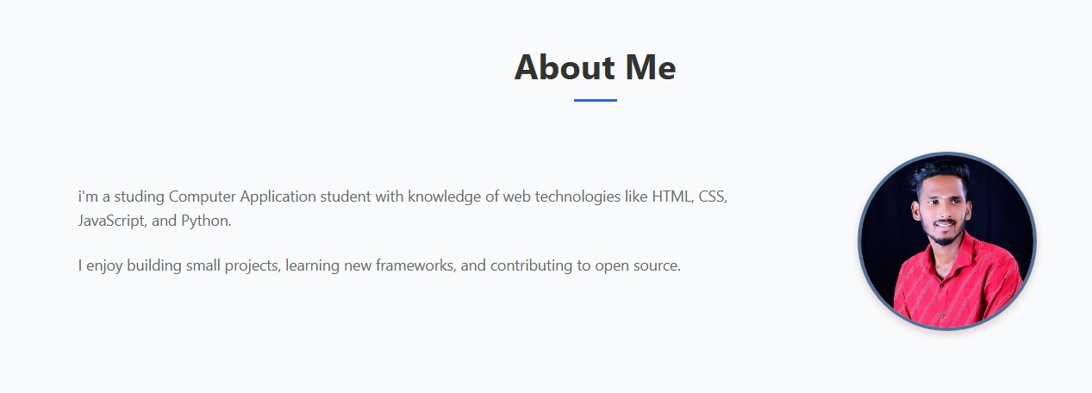
About Section – Displaying bio and profile avatar.

Slide 15
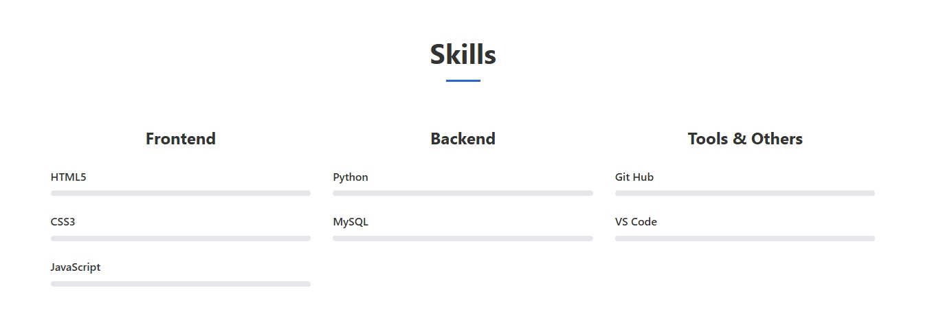
Skills Section – Listing skilled programming languages.

Slide 16
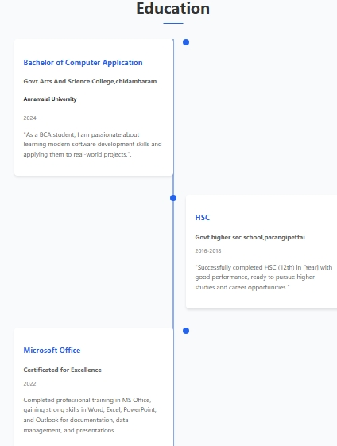
Education Section – College name, course, and highlights.

Slide 17
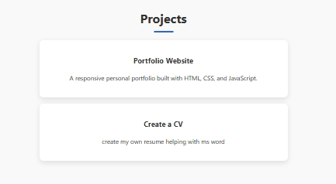
Project Section –portfolio and Resume file

Slide 18
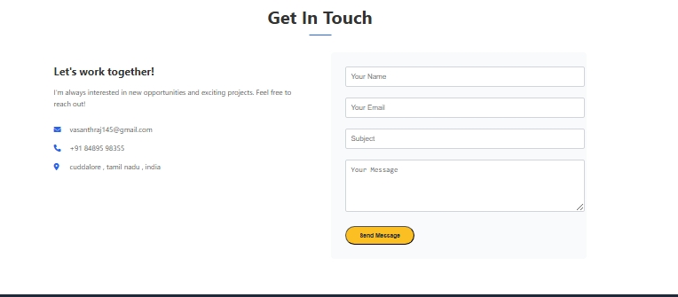
Contact Section – Email & address and contact form.

Slide 19
CONCLUSION
Conclusion for Digital Portfolio Project
Successfully created a digital portfolio website to showcase academic background, skills, and projects.
Improves professional visibility and makes it easier for employers to evaluate skills.
Acts as a living resume that can be continuously updated.
“THANK YOU”
21

